Slide 1
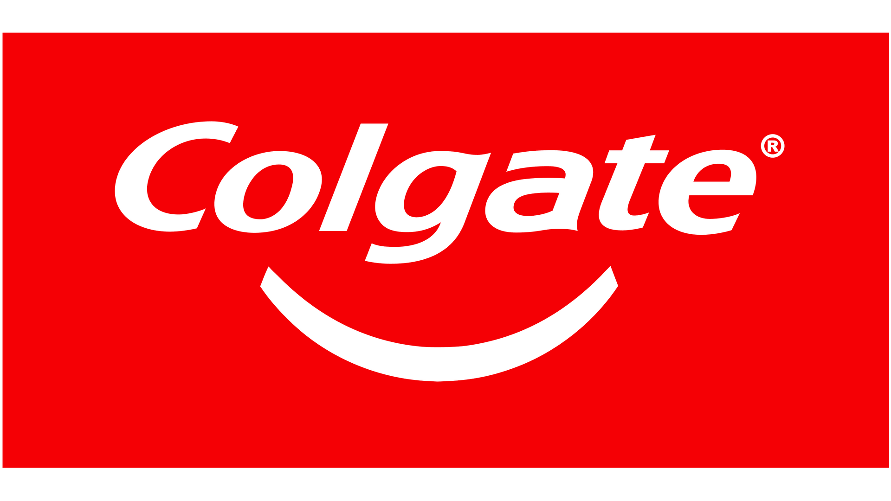

FLAVORED TOOTHPASTE
TEAM PUMA
Notes:
Part of the American Consumer Products Company Colgate Palm-Olive....Colgate is the sector that focuses on Oral Health and Dental Care w/products including Toothpaste, Toothbrushes, Mouthwash, Whitening Products, Floss + More

Slide 2
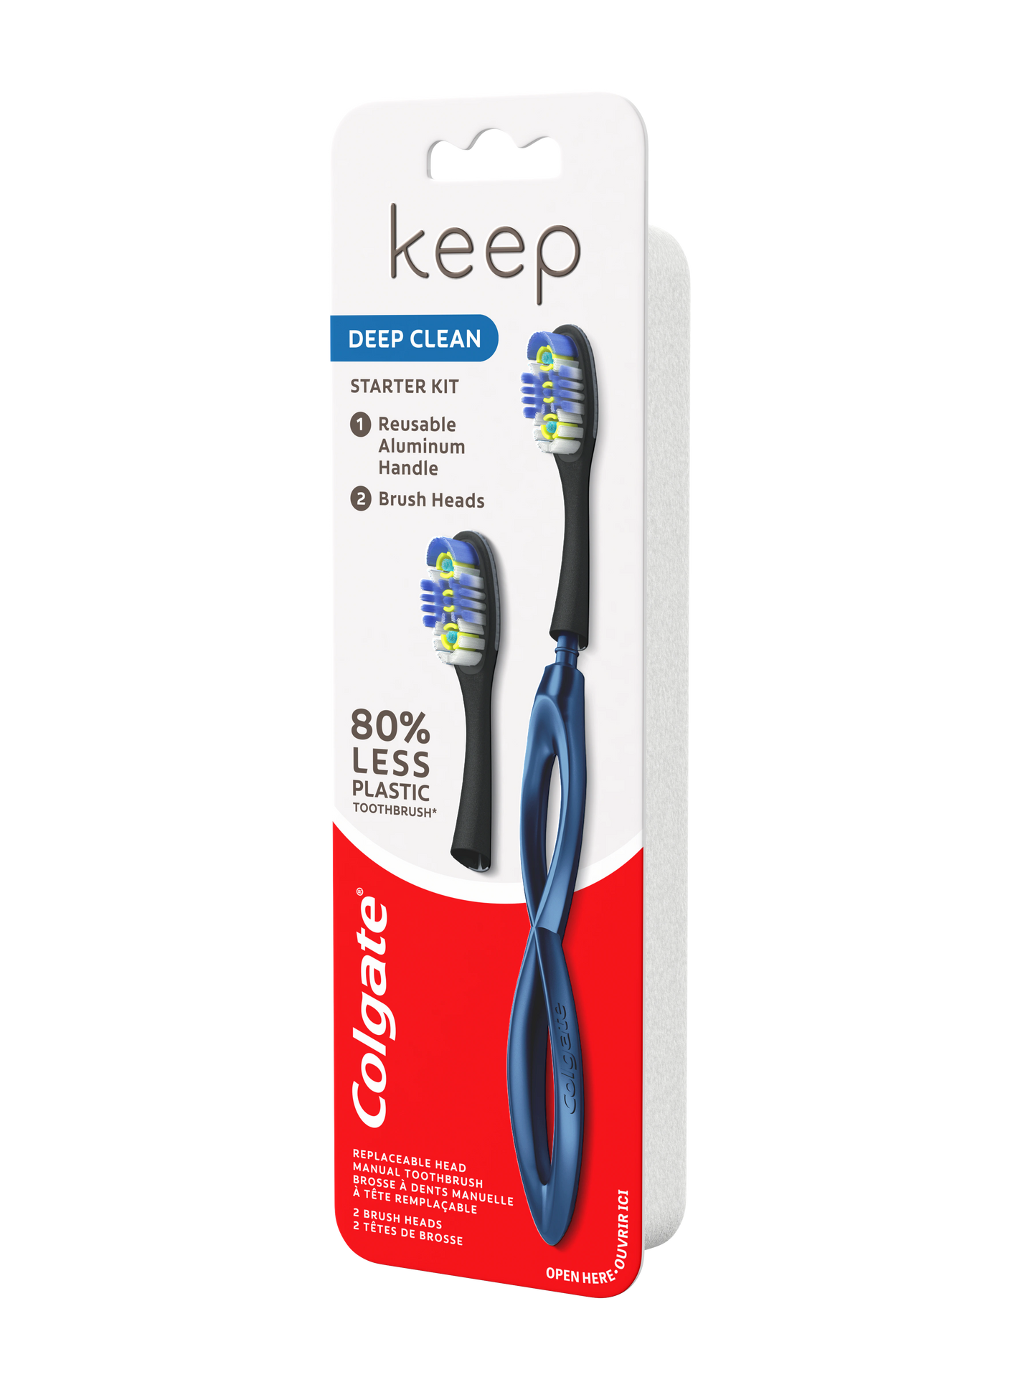




MISSION STATEMENT
Sparking optimism in everyone, every day
Product and Service Offerings
Empowering Oral Health
Colgate's 145-year-long Legacy
Sustainable Practices
Accessible Oral Healthcare
Gingivitis
Plaque Prevention
Fresh Breath
Cavity Prevention
Notes:
DJ

Slide 3

BUSINESS PROBLEM
Innovative toothpaste flavors for adults and young consumers in the USA
Success in market share growth, customer acquisition rates, brand perception
Growing demand for diverse toothpaste flavors
Notes:
DJ

Slide 4
DID YOU KNOW?
Inside US
33.3%
2/3 of Colgate's Revenue is From Outisde US
Outside US
66.7%
Notes:
DJ

Slide 5








FLAVORED TOOTHPASTE
Experience toothpaste like never before, because we're all kids at heart!!
Colgate
Colgate
Colgate
Colgate
Colgate
Colgate
Warm Spice
Matcha
Orange Burst
Lemon Mojito
Berry Blast
Coffee
Notes:
Solution Slide...Introduce a new flavored Toothpaste

Slide 6
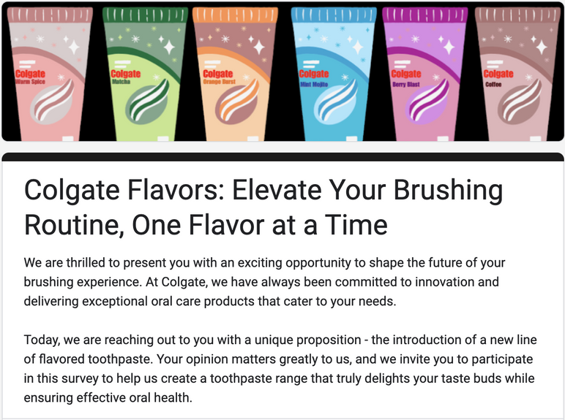
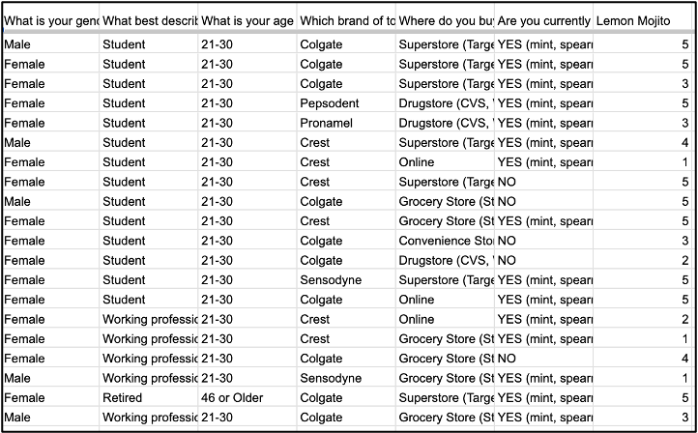
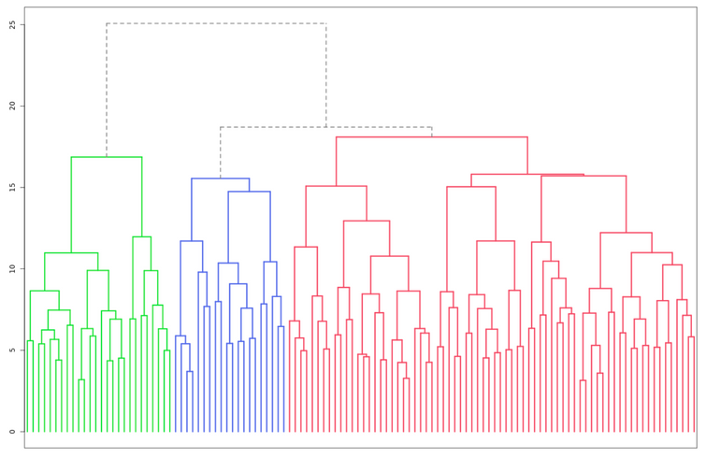
STEP 1:
SURVEY
CUSTOMER RESEARCH
STEP 2:
DATA
STEP 3:
ANALYSIS
Notes:
Siddharth

Slide 7
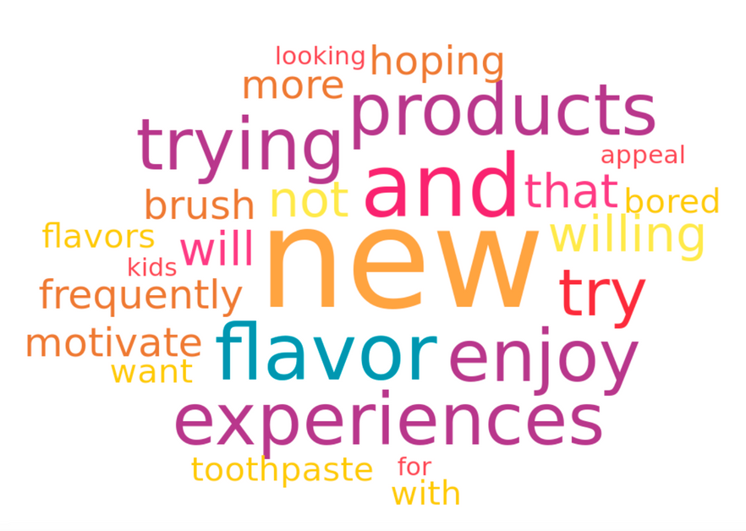
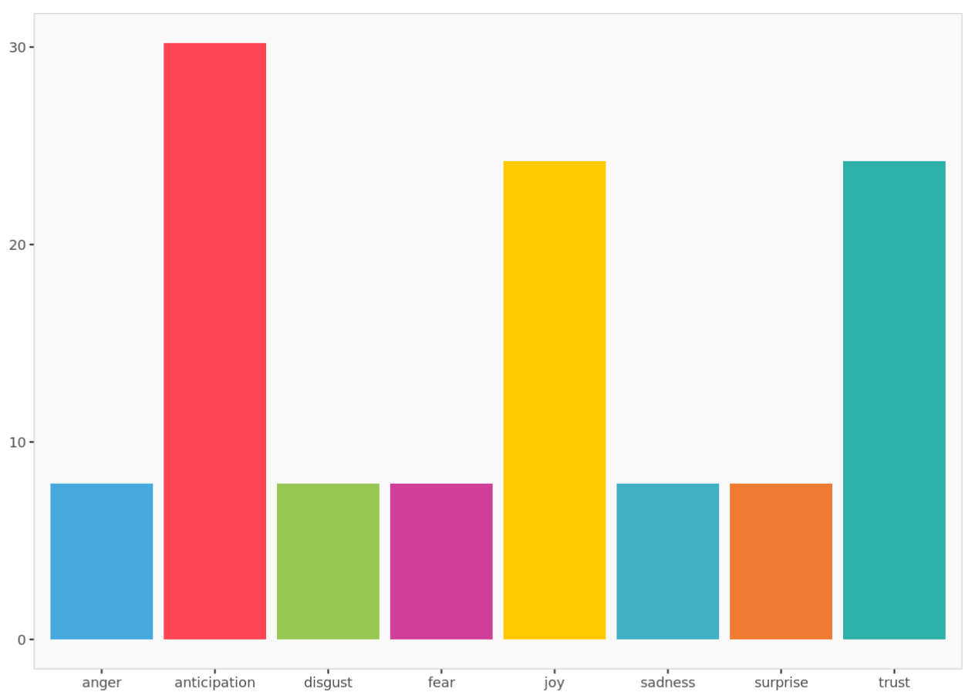
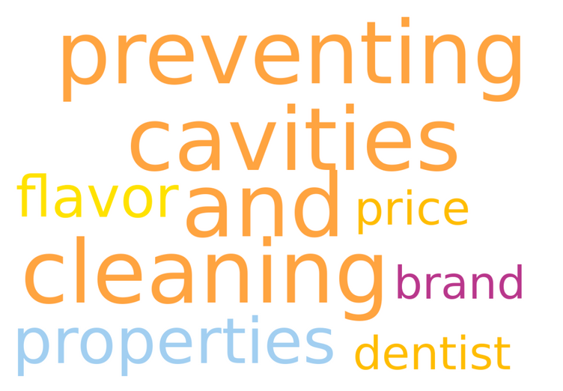
SENTIMENT
ANALYSIS

Slide 8
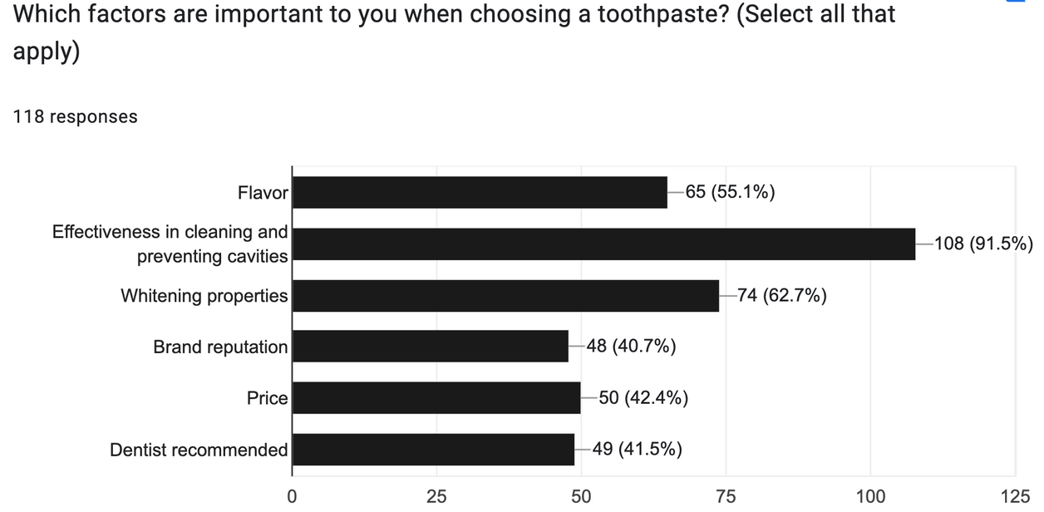
WHAT DOES THE DATA SAY?
Under 21
9.4%
Gender Ratio
Others
0.9 %
46 and elder
37.7%
21 - 30
42.3%
Age Ratio
Female
66%
Male
38.1%
31 - 45
10.6%
Do you think flavored toothpaste would make brushing your teeth more enjoyable?
67%
Notes:
Siddharth

Slide 9




SEGMENTATION
NO NONSENSE BRUSHERS
FLAVOR SEEKING PARENT PROFESSIONALS
SEASONED EXPLORERS: FEARLESS +45 PLUS
Notes:
Laura

Slide 10

TARGETING
Seasoned Explorers, Fearless + 45 Plus
Geographic: United States
Demographic: 45-65 Year Old Females
Psychographic: Love Trying new products and Switching up Routine
Behavioral: Shops for herself and her family, often buying toothpaste at the grocery store
Notes:
Laura

Slide 11
"For middle-aged women seeking a refreshing and enjoyable oral care experience, Colgate's Lemon Mojito Toothpaste is the ultimate choice among all toothpaste options. Unlike generic unflavored or mint toothpastes that cater to a wider audience, our product is exclusively crafted to satisfy the distinct taste preferences and oral health needs of this particular segment."
POSITIONING
Notes:
Gabby

Slide 12
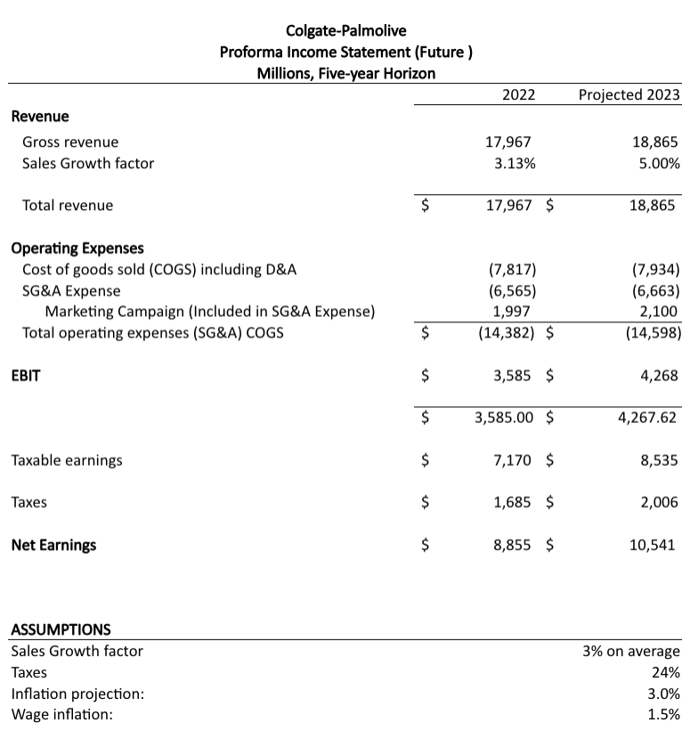
MARKETING STRATEGY
PART A - FINANCES
Notes:
Gabby

Slide 13
Marketing Budget Allocation
30%
10%
30%
10%
20%
TV
PRINT
DIGITAL
DIRECT MAIL
INSTORE
3.2208 million
1.0736 million
3.2208 million
1.0736 million
2.1472 million

Slide 14






MARKETING MIX
PRODUCT
PRICE
Limited edition
Lemon mojito
Refreshing
Zesty lime
Sugar-free
Fluoride
Cleans teeth
$5 for 12 oz tube
Competitive
Ingredient cost
Manufacturing expenses
Marketing expenses
Cost-effective
Value for money
PROMOTION
PLACE
Limited edition
End cap displays
Strategic shelf positioning
Cross-promotion
Sampling stations
In-store digital signage
Checkout counter placement
Distribution
Channels
Supermarkets
Drugstores
Online retailers
Dentists
Schools
Institutions

Slide 15
For a smile that's as refreshing as a mojito, and a refreshing lemony twist to start your day off right!!
FLAVORED

